Slide 1
Parent-Teacher-Student
Association
Mission: To expand educational opportunities and enhance the learning and social environment at Issaquah High through programs, volunteers, advocacy, and financial support.

Slide 2
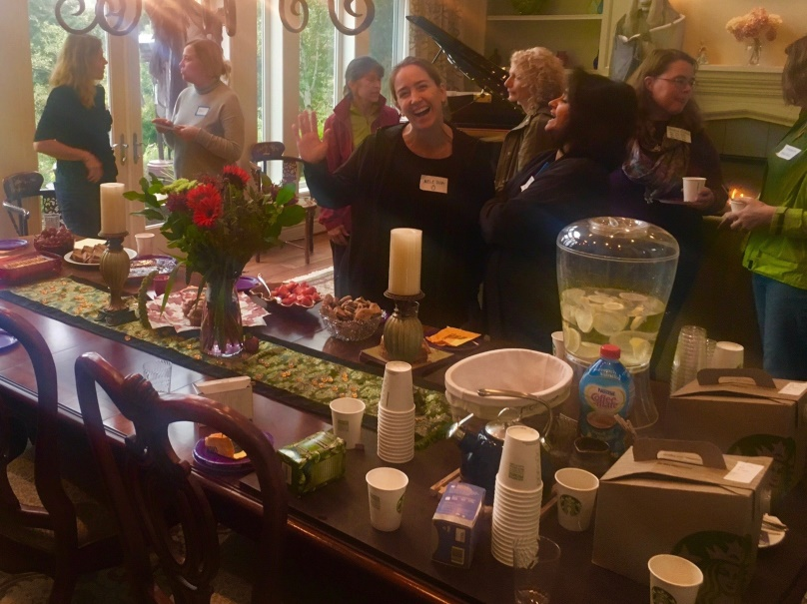
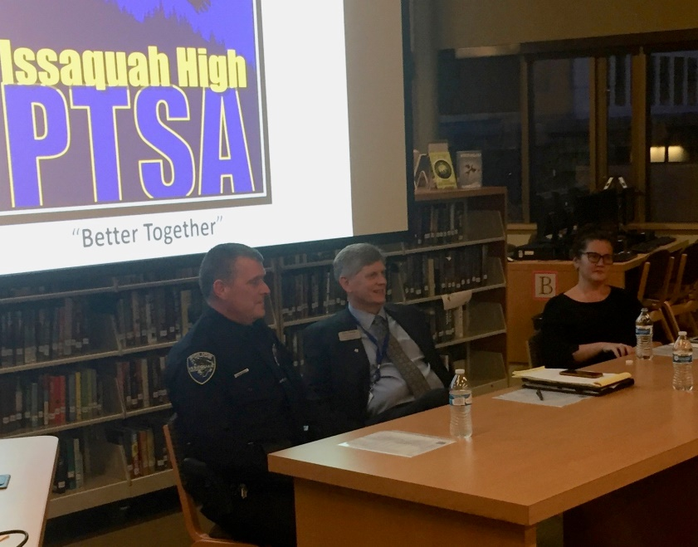
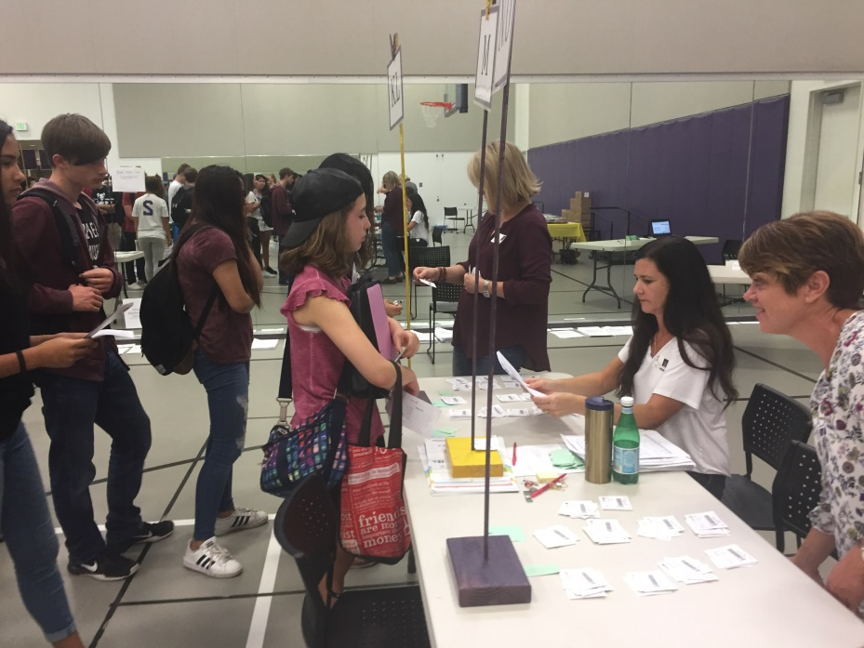
We Host Events
Welcome Gatherings for New Families
Monthly General Membership Meetings
College Planning Seminars
Picture Day & Textbook Checkout
ACT/SAT Practice Tests
Legislative Focus Day on Education
Parent Education Seminars
Community Service Day
Senior All Night Party

Slide 3
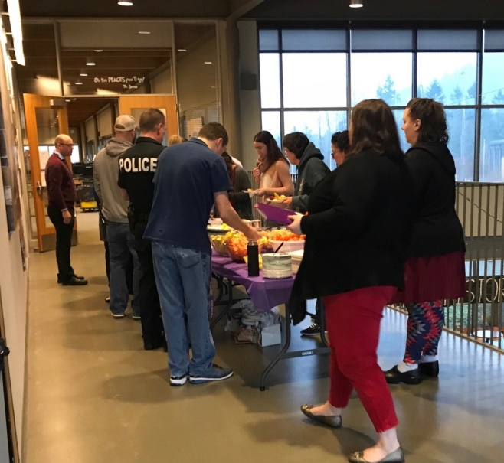
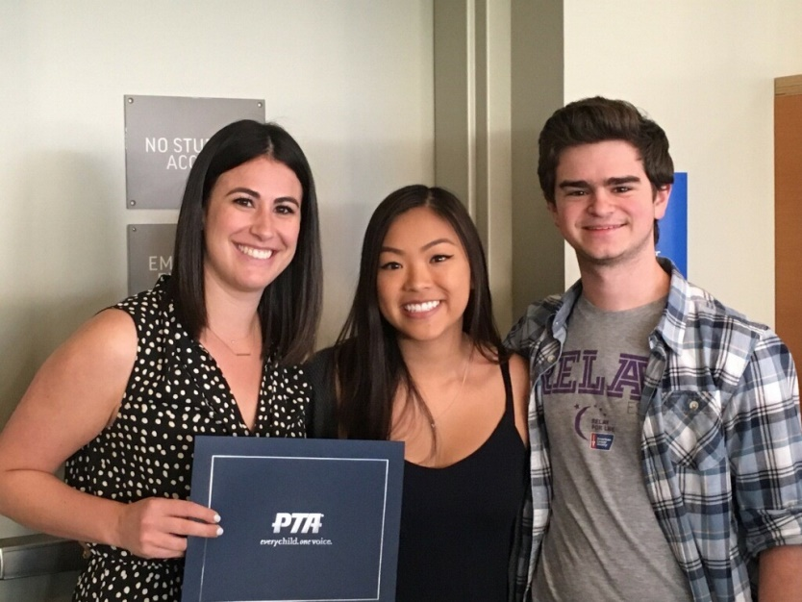
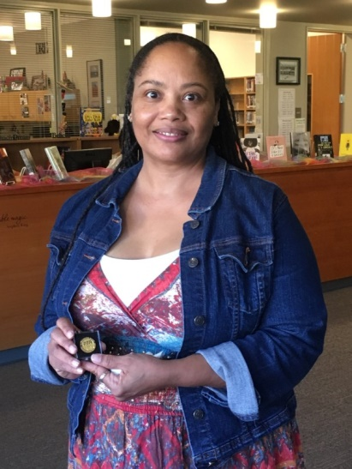
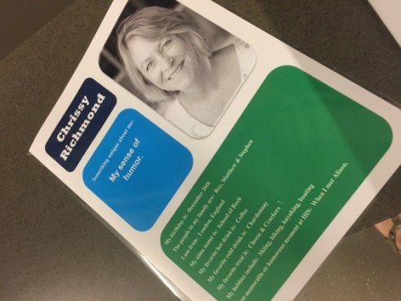
We Fund Needs
Monthly Teacher & Staff Breakfasts
Staff Appreciation Week
Grants & Aid for Identified Needs ($40k)
Extra Classroom Funds for Teachers
Safety Backpacks & Healthy Snacks
Angel Closet – Families in Need
Student Scholarships
Notes:
Drill Press – Robotics/Shop $ 820 Hugh O’Brien Youth Scholarships $1,700
Lunch for LRC I Community 230 “Drive to Save Lives” Speaker 750
Read Naturally Grant 760 IHS Radio Club 825
Spanish National Exam 300 PE 5K T-Shirts for Top Performers 500
Student Academic Fund 4,000 Teacher Classroom Fund 4,500
Angel Support 8,700 Issaquah Schools Foundation 1,000
ISD Summer School 375 Volunteers for Issaquah Schools 1,350
Echo Glen 100 Academy for Comm. Transition 50
Issaquah Food Bank 1,000 French Magazine Subscriptions 300
CycleOps Fluid Bike Trainer 420 Issaquah Speaks Scholarships 500
ELL US History Textbooks 1,000 Stationary Bikes for PE students 2,000
Calming Kits 200 Senior Scholarships 8,000
Shakespeare Grant 1,000

Slide 4
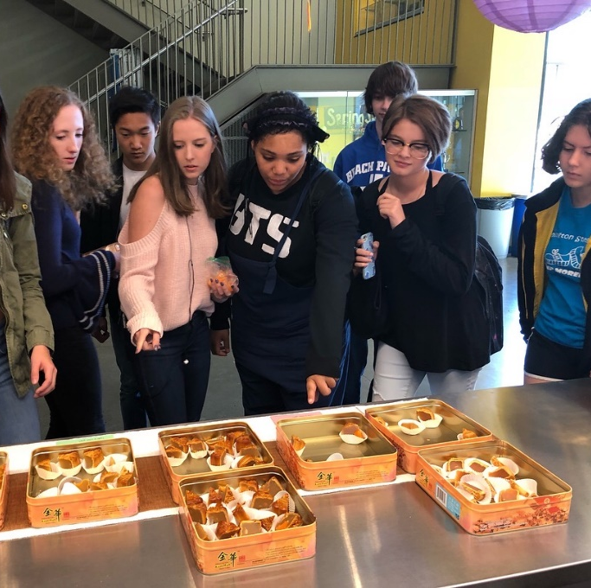
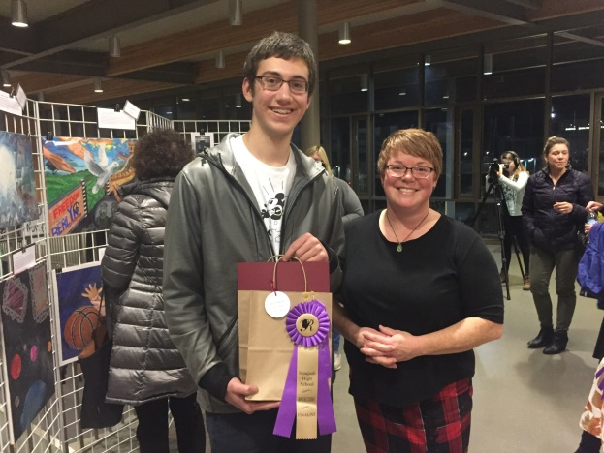
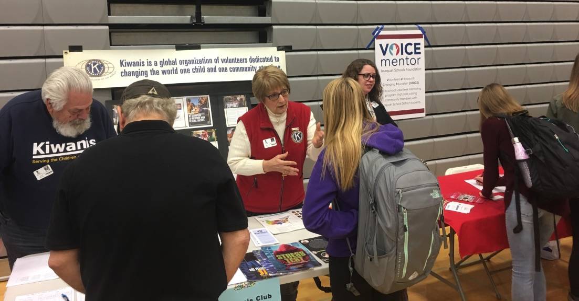
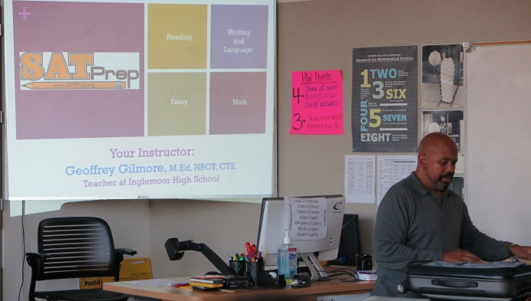
Our Programs
Reflections National Art Competition
Community Service Honor Cords
New Family Ambassadors
Healthy Student Support
College Prep, also supporting Ask A Counselor Night & CCC’s College Fair

Slide 5
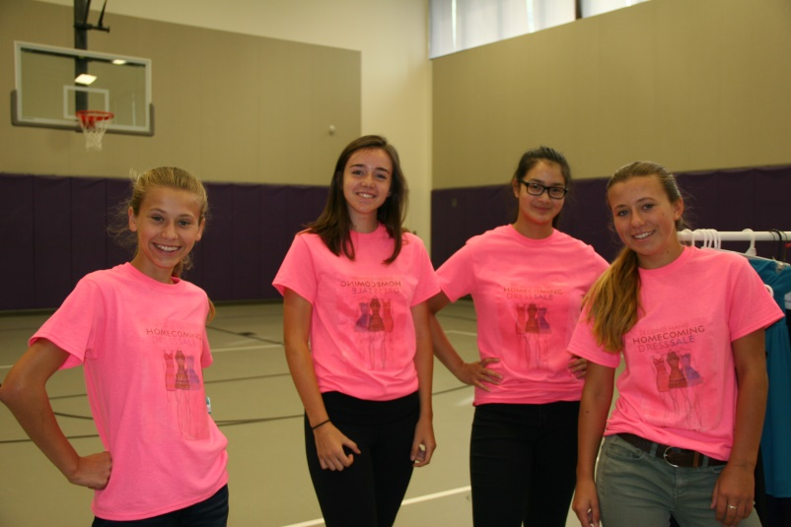
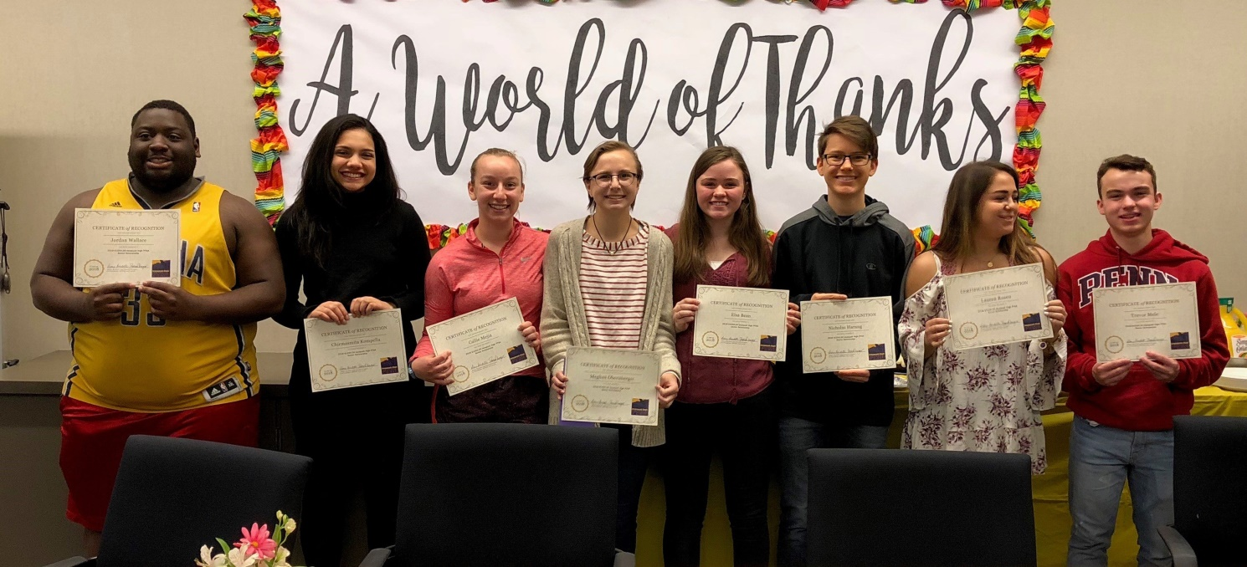
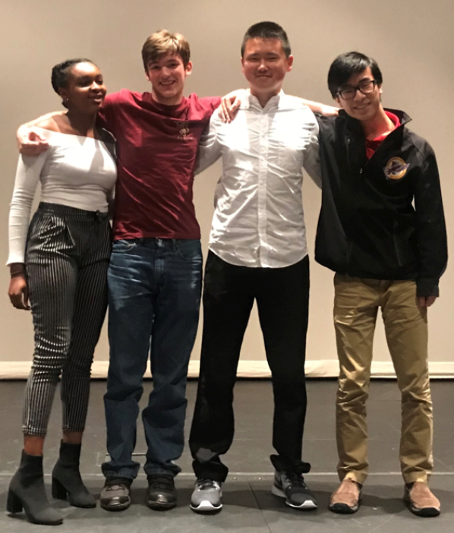
Examples of Direct Student Support
Cash prizes for “Issaquah Talks”
$1000 Senior Scholarships
Senior Events (Breakfast & Farewell)
Financial assistance and weekend food (e.g. PTSA provides tickets to prom, homecoming, and others)

Slide 6
Share Your Voice with Us!
www.issaquahhighptsa.org
www.facebook.com/IssaquahHighPTSA/
IHPTSAPresidents@gmail.com
Look for Upcoming Survey
Come to General Meetings (open to all)
Next meeting Sept. 21
9 am social with snacks
9:30-11:30 am meeting time
Park in back by the stadium in staff parking
Principal available for questions

